Slide 1
Digital image processing and analysis 2. What digital images are like
Professor Ela Claridge
School of Computer Science

Slide 2
Previous lecture:
Basics of visual perception
Digital image acquisition
Inside digital cameras
Imaging devices
… and how these two compare

Slide 3
In this lecture we shall find out about:
Digital image properties
Computer representation – pixels
Sampling – related to image coordinates
Quantisation – related to image values
… and how they relate to image acquisition

Slide 4
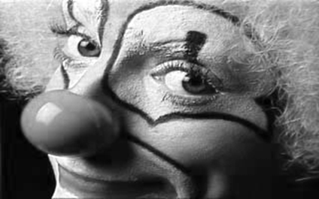
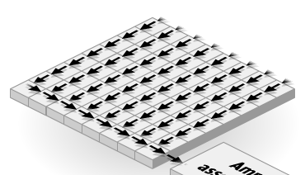

Digital image
Real world object / analogue image is projected onto a sensor array
CCD

Slide 5
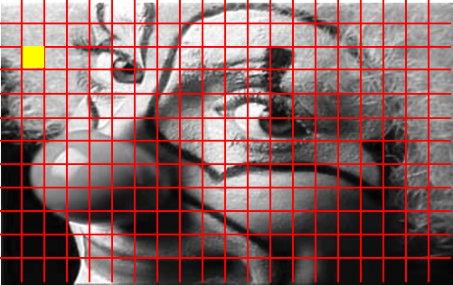
Digital image
Stored as a rectangular grid of picture elements (pixels)
Grid has
Width
Height
Spatial resolution
Pixel has
Location (row, column)
Value
column
row

Slide 6
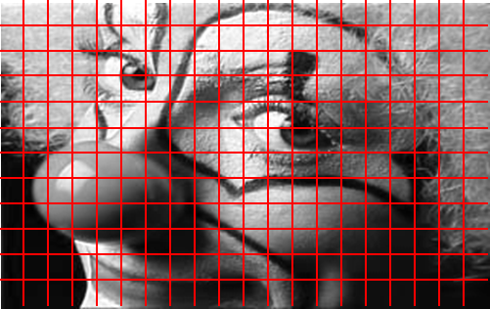
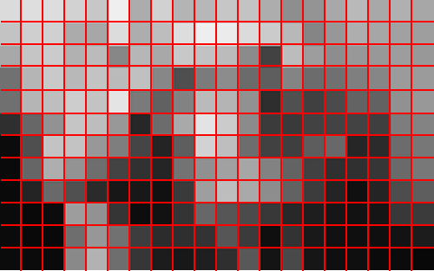
Digital image Pixel resolution and spatial resolution
Pixel resolution
The number of pixel columns (width) and the number of pixel rows (height), e.g. 640 × 480
Total number of pixels in the image, e.g. 640 × 480 = 307,200
Spatial resolution (sampling frequency)
The number of independent pixel values per unit length

Slide 7


Digital image Sampling: image size and spatial resolution
Real world size: 320 x 200 mm
Displayed image size: 320 x 200 mm
Displayed image size: 160 x 100 mm
200 pix
100 pix
160 pix
320 pix
Real size: 320 x 200 mm
Digital image size: 320 x 200 pixels
Spatial resolution: 1 pixel per mm
Real size: 320 x 200 mm
Digital image size: 160 x 100 pixels
Spatial resolution: 0.5 pixels per mm
Spatial resolution = sampling frequency

Slide 8

Digital image Sampling: image size and spatial resolution
Real world size: 320 x 200 mm
Magnified 160 x 320 image
Displayed image size: 320 x 200 mm
Displayed image size: 320 x 200 mm
200 pix
100 pix
320 pix
160 pix
Real size: 320 x 200 mm
Digital image size: 320 x 200 pixels
Spatial resolution: 1 pixel per mm
Real size: 320 x 200 mm
Digital image size: 160 x 100 pixels
Spatial resolution: 0.5 pixels per mm
Spatial resolution = sampling frequency

Slide 9
Digital image Sampling frequency
Spatial resolution depends on how finely the image is sampled during digitization.
Higher spatial resolution images have a greater number of pixels for the same physical size.
When a real-world data is under-sampled, detail can be lost or obscured.
When it is over-sampled, storage is wasted.
To accurately preserve the spatial resolution sampling interval should be equal to half the size of the smallest detail we wish to preserve (the Nyquist criterion).
Sampling interval is the inverse of the sampling frequency.

Slide 10




Digital image Effect of reducing sampling frequency
1 pixel / mm
= 1 mm/pixel
0.5 pixel / mm
= 2 mm/pixel
Display size is the same
0.25 pixels / mm
= 4 mm/pixel
0.125 pixels / mm
= 8 mm/pixel

Slide 11
Digital image Quantisation
The intensity of light falling on a pixel is digitised and recorded as a digital number.
A digital number is stored with a finite number of bits (binary digits).
The number of bits determine the radiometric resolution of the image.
The detected intensity value needs to be scaled and quantized to fit within the range of value available for storage.

Slide 12

Digital image Quantisation: pixel values
228 | 224 | 216 | 204 | 199 | 202 | 207 | 197 | 207 | 215 | 207 | 208 | 204 | 198 | 184 | 192
218 | 206 | 199 | 200 | 207 | 210 | 208 | 202 | 212 | 218 | 215 | 210 | 201 | 188 | 174 | 197
200 | 200 | 203 | 204 | 204 | 199 | 197 | 207 | 210 | 203 | 196 | 191 | 194 | 193 | 193 | 198
209 | 219 | 221 | 211 | 201 | 203 | 213 | 200 | 200 | 190 | 188 | 184 | 193 | 197 | 203 | 205
223 | 225 | 223 | 208 | 186 | 176 | 176 | 173 | 176 | 171 | 178 | 180 | 194 | 201 | 212 | 198
200 | 191 | 184 | 167 | 127 | 76 | 42 | 63 | 63 | 57 | 68 | 81 | 112 | 136 | 156 | 169
212 | 214 | 182 | 91 | 41 | 49 | 49 | 38 | 40 | 42 | 40 | 37 | 38 | 50 | 61 | 95
216 | 198 | 136 | 65 | 60 | 62 | 24 | 34 | 41 | 46 | 42 | 36 | 34 | 37 | 40 | 42
205 | 181 | 141 | 101 | 96 | 84 | 46 | 40 | 48 | 50 | 40 | 34 | 37 | 38 | 33 | 35
181 | 150 | 128 | 96 | 64 | 44 | 33 | 38 | 49 | 46 | 34 | 32 | 43 | 45 | 37 | 37
193 | 153 | 100 | 65 | 48 | 39 | 36 | 36 | 44 | 42 | 32 | 35 | 46 | 46 | 34 | 34
197 | 159 | 90 | 62 | 56 | 48 | 44 | 43 | 44 | 38 | 29 | 32 | 41 | 40 | 31 | 30
Higher value = brighter

Slide 13
Digital image Quantisation: pixel values
228 | 224 | 216 | 204 | 199 | 202 | 207 | 197 | 207 | 215 | 207 | 208 | 204 | 198 | 184 | 192
218 | 206 | 199 | 200 | 207 | 210 | 208 | 202 | 212 | 218 | 215 | 210 | 201 | 188 | 174 | 197
200 | 200 | 203 | 204 | 204 | 199 | 197 | 207 | 210 | 203 | 196 | 191 | 194 | 193 | 193 | 198
209 | 219 | 221 | 211 | 201 | 203 | 213 | 200 | 200 | 190 | 188 | 184 | 193 | 197 | 203 | 205
223 | 225 | 223 | 208 | 186 | 176 | 176 | 173 | 176 | 171 | 178 | 180 | 194 | 201 | 212 | 198
200 | 191 | 184 | 167 | 127 | 76 | 42 | 63 | 63 | 57 | 68 | 81 | 112 | 136 | 156 | 169
212 | 214 | 182 | 91 | 41 | 49 | 49 | 38 | 40 | 42 | 40 | 37 | 38 | 50 | 61 | 95
216 | 198 | 136 | 65 | 60 | 62 | 24 | 34 | 41 | 46 | 42 | 36 | 34 | 37 | 40 | 42
205 | 181 | 141 | 101 | 96 | 84 | 46 | 40 | 48 | 50 | 40 | 34 | 37 | 38 | 33 | 35
181 | 150 | 128 | 96 | 64 | 44 | 33 | 38 | 49 | 46 | 34 | 32 | 43 | 45 | 37 | 37
193 | 153 | 100 | 65 | 48 | 39 | 36 | 36 | 44 | 42 | 32 | 35 | 46 | 46 | 34 | 34
197 | 159 | 90 | 62 | 56 | 48 | 44 | 43 | 44 | 38 | 29 | 32 | 41 | 40 | 31 | 30
Higher value = brighter

Slide 14
Digital image Quantisation: binary digits
8 bits per pixel
2⁷ | 2⁶ | 2⁵ | 2⁴ | 2³ | 2² | 2¹ | 2⁰
128 | 64 | 32 | 16 | 8 | 4 | 2 | 1
0 | 0 | 0 | 0 | 0 | 0 | 0 | 0 | 0
0 | 0 | 0 | 0 | 0 | 0 | 1 | 1
0 | 0 | 1 | 0 | 1 | 0 | 0 | 0
0 | 0 | 1 | 0 | 1 | 1 | 0 | 0
1 | 1 | 1 | 1 | 1 | 1 | 1 | 1
3
3
40
3
40
44
3
40
44
255
Example
0*128 + 0*64 + 1*32 + 0*16 + 1*8 + 1*4 + 0* 2 + 0*1 = 44

Slide 15
Digital image Quantisation: binary digits
Bits per pixel | Min value | Max value | Number of quantization levels
1 | 0 | 1 | 1
8 | 0 | 255 | 255
12 | 0 | 4,095 | 4,095
16 | 0 | 65,535 | 65,535

Slide 16
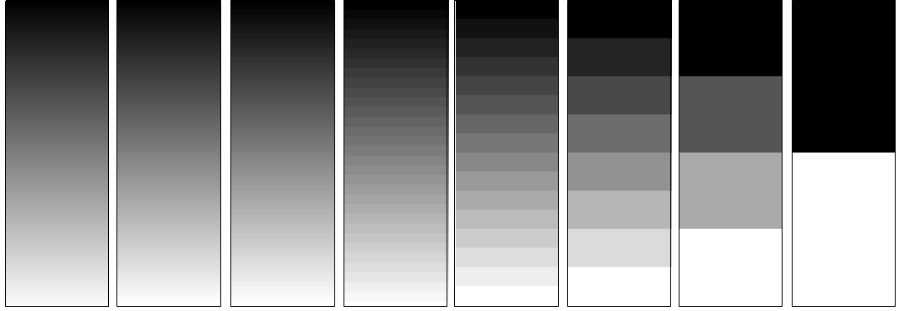
Digital image Quantisation: radiometric resolution
Radiometric resolution: the smallest change in intensity level that can be detected by the sensing system.
Limited by the number of discrete quantization levels used to digitize the continuous intensity value.
256
128
64
32
16
8
4
2

Slide 17
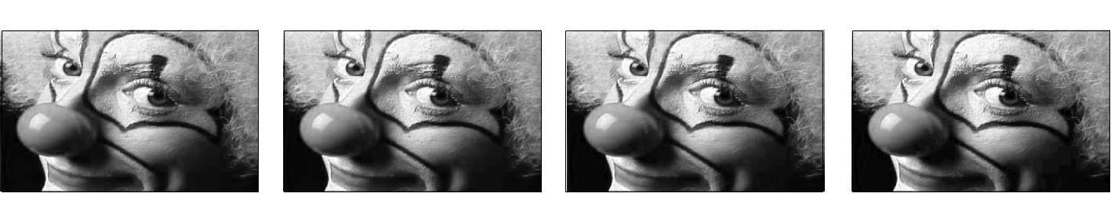
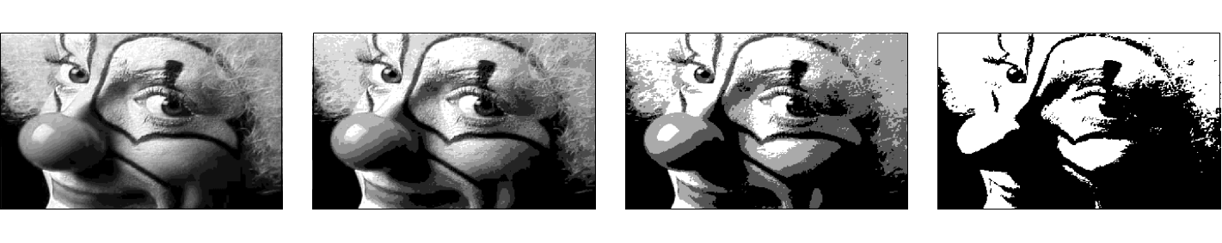
Digital image Quantisation: radiometric resolution
256
128
64
32
16
8
4
2
At how many b.p.p. you start noticing the difference?

Slide 18

Digital image Dynamic Range and Full Well Capacity
The dynamic range of a sensor is defined as the full-well capacity divided by the camera noise.
It relates to the ability of a camera to record simultaneously very low and very bright light signals.
When the well reaches the full capacity the charge starts to fill adjacent pixels, resulting in blooming.

Slide 19
Pathways (Lecture 1)
Photons of light
Sensor
Charge generation
Photoelectrons
Potential
well
Collection and storage of liberated charge
Charge
Amplifier
Charge transfer
Voltage
ADC
Charge measurement
Numerical values
ADC=Analogue-to-Digital Converter

Slide 20
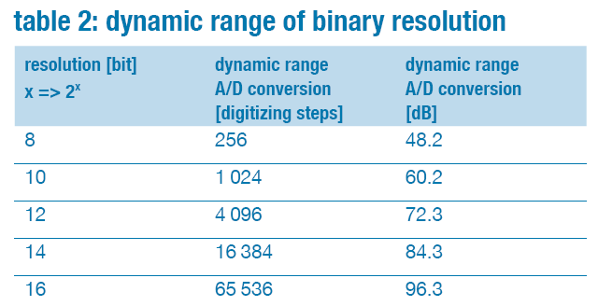
Digital image Dynamic Range and Full Well Capacity
https://www.pco-tech.com/fileadmin/user_upload/db/download/kb_dynamic_range_20100813.pdf

Slide 21
In this lecture we have covered:
Digital image properties
Computer representation – pixels
Sampling – related to image coordinates
Quantisation – related to image values
… and how they relate to image acquisition

Slide 22
Next lecture
Colour: physical origins, perception and characterisation

Slide 23

Next lecture:
FIJI (ImageJ) image processing and analysis software
Essentials
Basic concepts
Overview of functions and tools
Macros and programming
You can download your own copy:
https://imagej.net/Fiji/Downloads

Slide 24
Further reading and experimentation
Sampling frequency: http://micro.magnet.fsu.edu/primer/java/digitalimaging/processing/samplefrequency/index.html
Spatial and brightness resolution: http://micro.magnet.fsu.edu/primer/digitalimaging/digitalimagebasics.html
Spatial and brightness resolution, interactive tutorials: http://micro.magnet.fsu.edu/primer/java/digitalimaging/processing/bitdepth/index.html
http://micro.magnet.fsu.edu/primer/java/digitalimaging/processing/spatialresolution/index.html

